Slide 1
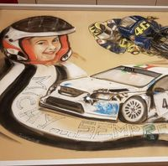
PRESENTANO PRÄSENTIERT INTRODUCE
PRESENTAN

Slide 2
MICHY MOTOR DAY 2024
AN EVENT PROMOTED BY THE 'MICHY sempre con Noi' ASSOCIATION
Who was Michele and what is Michy Motor Day.
Michele, known to everyone as Michy, was born on 29 March 2005. His and his family's life changed drastically in the summer of 2014 when he was diagnosed with bone sarcoma: one of the deadliest forms of paediatric cancer. After almost a year of intensive treatment, the tumour seems to have been defeated, but after only three weeks a recurrence occurs that will prove lethal. In November 2015 Michy was born to Heaven, leaving an unbridgeable void in those who had the fortune to share his earthly path.
On her first birthday in Heaven, her parents and friends organised an event in his memory: the 'Michy Motor Day'.
The whole of Abbadia Lariana gathered around and, in addition to giving local children and young people a Rally experience, which was one of Michy's passions, they also collected a contribution that was used to purchase medical equipment to help those who would have had the same experience as Michy and his parents.

Slide 3
MICHY MOTOR DAY 2024
AN EVENT PROMOTED BY THE 'MICHY sempre con Noi' ASSOCIATION
Who was Michele and what is Michy Motor Day.
Since then the 'Michy Motor Day' has been held every year and the group formed by Michy's parents and friends decided to give this a stable form by founding the association 'Michy... Always with Us'.
'Of course we are not going to change the world, but we are trying to build something good by making sure that Michy's memory can stay alive in the minds of those who knew him' say the organisers.
It is a festive weekend where children can meet the world of rallying and motors that was a great passion of Michy. In addition to the exhibition on the lakeside, there is a rally circuit along which children are taken on board rally cars driven by some famous rally pilots.
It is with great pleasure and honour that the Unimog Club Italia has accepted the invitation to participate in this great event, which will be held in the enchanting town of Abbadia Lariana, a stone's throw from Lecco. It will be a very pleasant opportunity to show Unimogs to children, young people and, in general, to enthusiasts and the public who will attend the event.
Participation is free of charge for Unimog Club Italia members who turn up with their vehicles.

Slide 4
MICHY MOTOR DAY 2024
AN EVENT PROMOTED BY THE 'MICHY sempre con Noi' ASSOCIATION
The programme for Sunday 5 May 2024.
The arrival of the Unimog crews is planned from 08:00 to 08:30. After registration, the vehicles will be parked next to the church, where a mass will be held in memory of Michy at 10.30.
In the meantime, crews are free to look around the event site.
At the end of the mass, the engines will be switched on to say goodbye to Michy, and afterwards it will be possible to visit the 'Setificio Monti' Civic Museum, a real gem that takes us back to times gone by.
At 13:00, those who wish can have lunch and enjoy the specialities prepared by the association's Staff.
In the afternoon, there will be the opportunity to relax on the beach, a peaceful spot with a marvellous view of the Lario and the "mountains rising out of the water and into the sky".
Our participation is scheduled to end at 18:00.
NOTE: the funds raised by the organisers during the event will be donated to the Paediatric Department of the National Cancer Institute of Milan

Slide 5
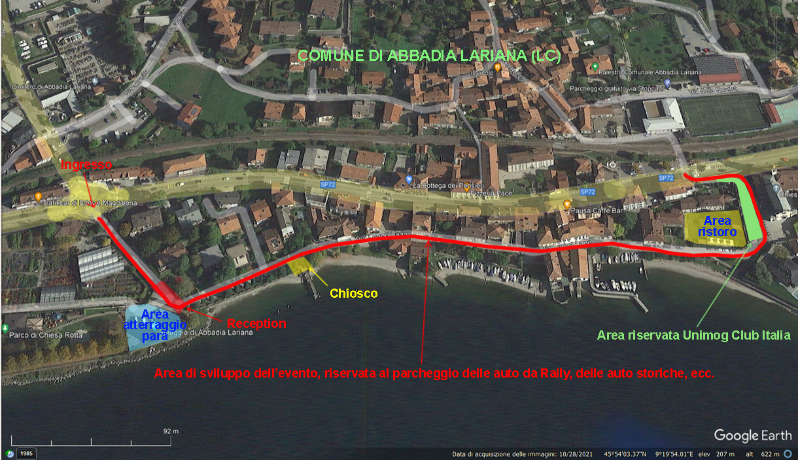
MICHY MOTOR DAY 2024
UN EVENTO PROPOSTO DALL’ASSOCIAZIONE ‘MICKY sempre CON NOI’

Slide 6
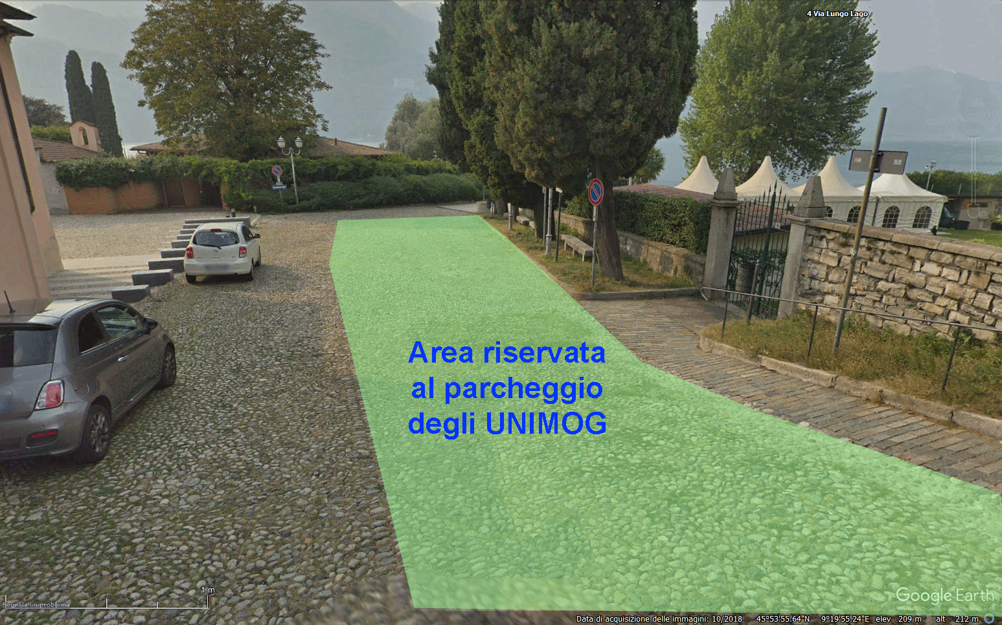
MICHY MOTOR DAY 2024
UN EVENTO PROPOSTO DALL’ASSOCIAZIONE ‘MICKY sempre CON NOI’

Slide 7
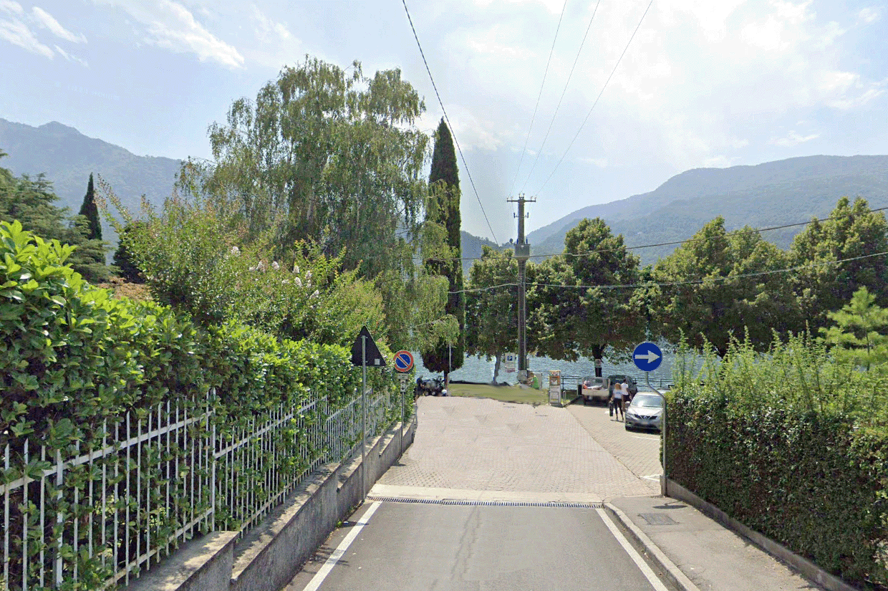
RECEPTION

Slide 8
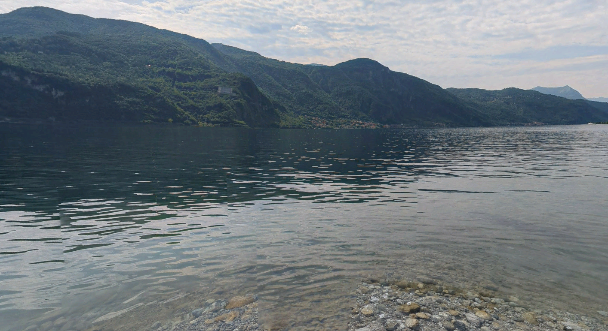
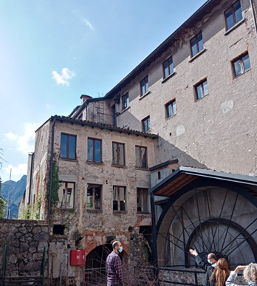
Relax in spiaggia
Punto di ritrovo
Mandello del Lario
Visita al Museo

Slide 9
Event Programme:
SUNDAY, May 05th 2024:
08:00 Presentation at the Reception in Abbadia Lariana, Via Lungolago, entrance from the roundabout on Via Nazionale at number 30;
08:10 Assembly and parking of Unimogs in the reserved area in front of the Church. Crews at their ease;
10:30 Holy Mass in memory of Michy;
11:30 Visit to the Civic Museum ‘Setificio Monti’;
13:00 Lunch organised by the Association's staff (at extra charge);
14:00 Relaxation on the beach or transfer on foot to attend the Rally trials;
18:00 Greetings and farewell from the event.

Slide 10
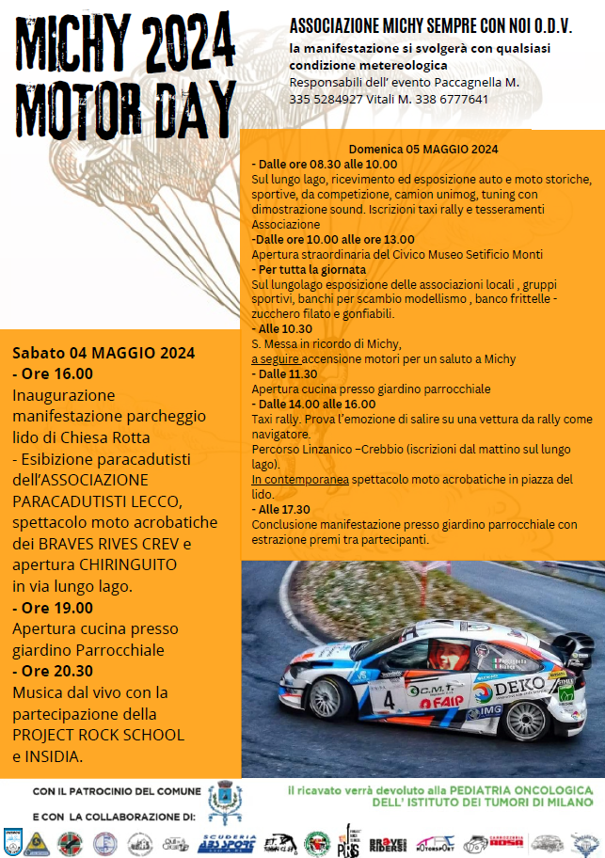

Slide 11
Grazie!
Vielen Dank!
Thank you!
¡Gracias!

